Slide 1
Dinosaur Eggshells and Nest From South Korea

Slide 2
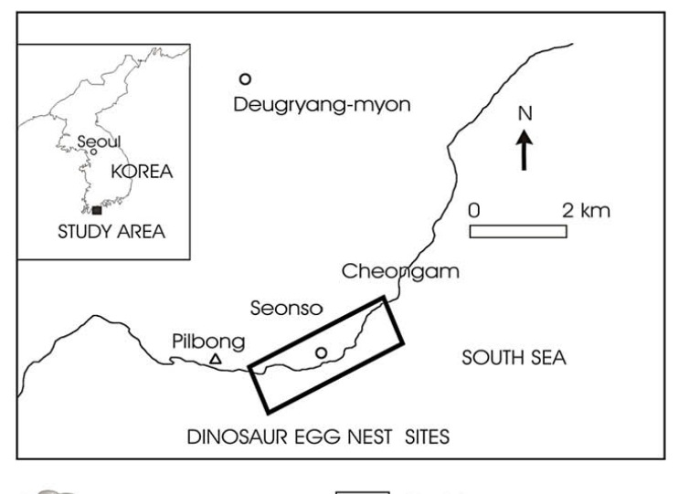
Geologic Setting

Slide 3
Geologic Setting
Time Period: Late Cretaceous
consists of conglomerates, pebbly sandstones, sandstones, and mudstones.
pebbles consist of igneous and volcanic fragments.

Slide 4
Findings
More than 200 dinosaur eggs and 17 nests have been collected

Slide 5
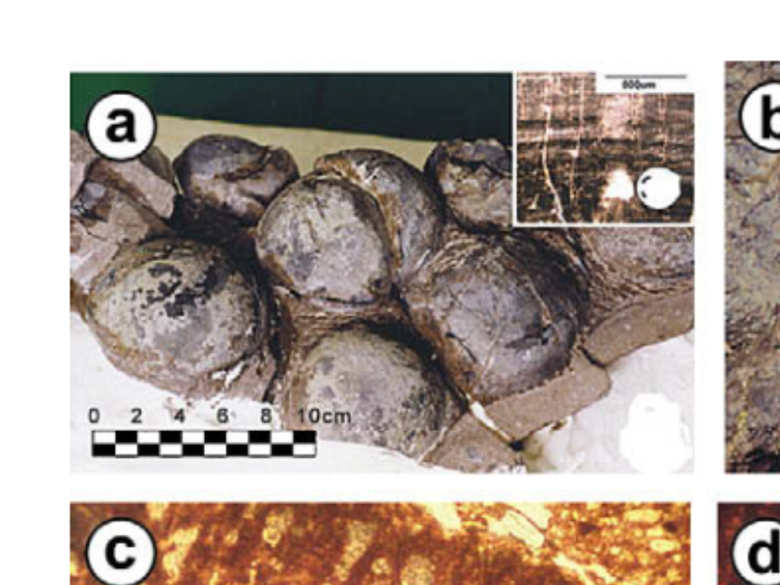
Dinosaur Eggs

Slide 6
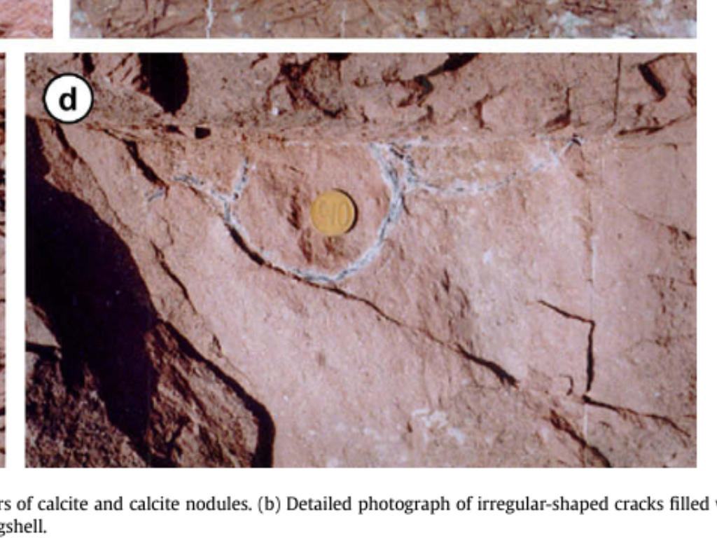
Dinosaur Nest

Slide 7
Oxygen Value for Calcites
the measured pedogenic calcite d18O values would require the temperature to be >80 °C
Why so high?

Slide 8
Eggshell Oxygen Values
the d18O values of the eggshell might indicate cooler environmental conditions that were favorable for dinosaurs
About 25 􏰂± 5 °C

Slide 9
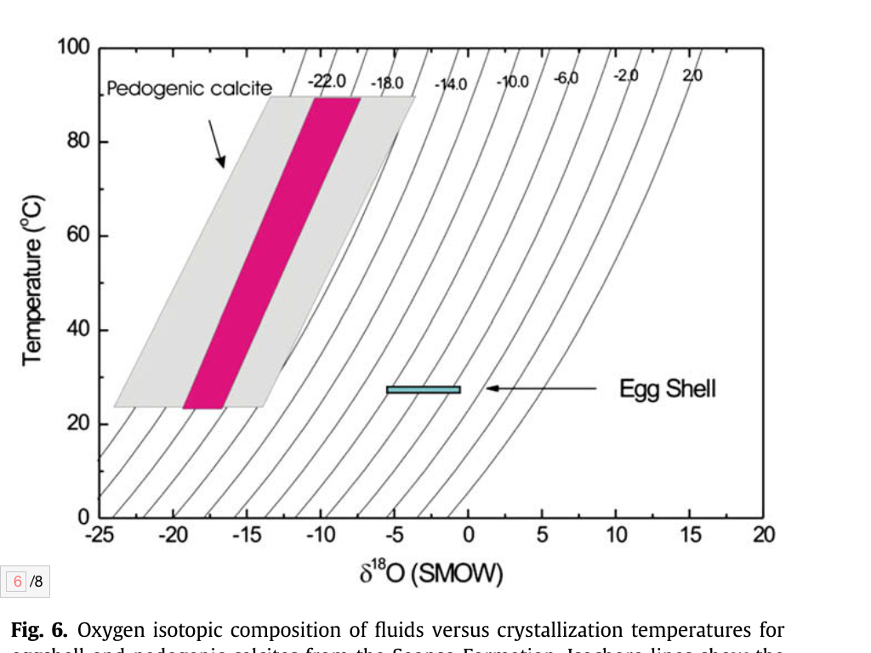

Slide 10
Carbon Value for Calcites
Suggests soil carbonate formed from C3 dominated vegetation
The assumption that a local ecosystem was composed of 100% C3 biomass places an upper limit on atmospheric CO2

Slide 11
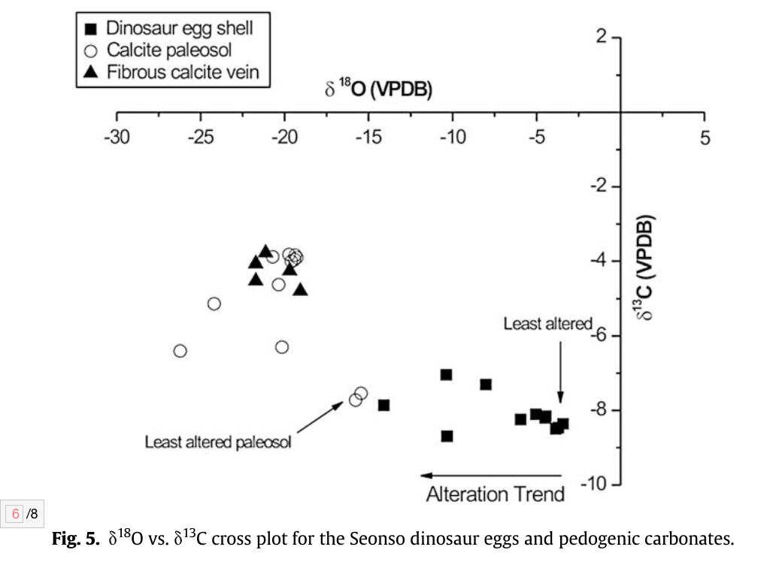
Oxygen vs. Carbon

